Slide 1
Cluster Analysis
Group-5

Slide 2
Architecture:
Kick off and Business Objective discussion
EDA
Model Building
Model Evaluation
Conclusion
Deployment

Slide 3
Business objective
Creating clusters on global development measurement dataset

Slide 4
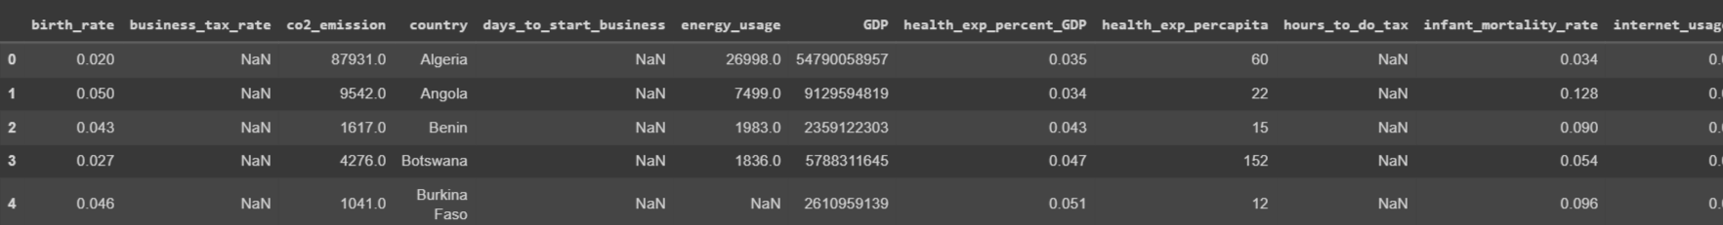
Data set

Slide 5
Veriable Desccripton
Birth Rate, Business tax, CO2emissions, Country, Days to start business, Ease of business, energy usage, GDP, healthexp%GDP, healthexp/capita, hours to do tax, infant mortality, internet usage, lending rate, life expectancy female, etc.

Slide 6
Data set detail:
The dataset has information about important economic and development metrics related to various countries across the globe.

Slide 7
EDA
Data cleaning or preprocessing step where certain values in specific columns are considered outliers or invalid, and they are replaced with NaN for further analysis.
Whichever countries having null values for the entire feature, imputing those countries with median value of that feature from all the countries.

Slide 8
#Interpretations on Skewness of Features .lending_interest, GDP, population_total, co2_emission, days_to_start_business, tourism_inbound, energy_usage, tourism_outbound features are highly skewed
.Need to find a way to reduce the skewness for the above mentioned features
#Before imputation let us check for outliers using boxplot and histograms

Slide 9
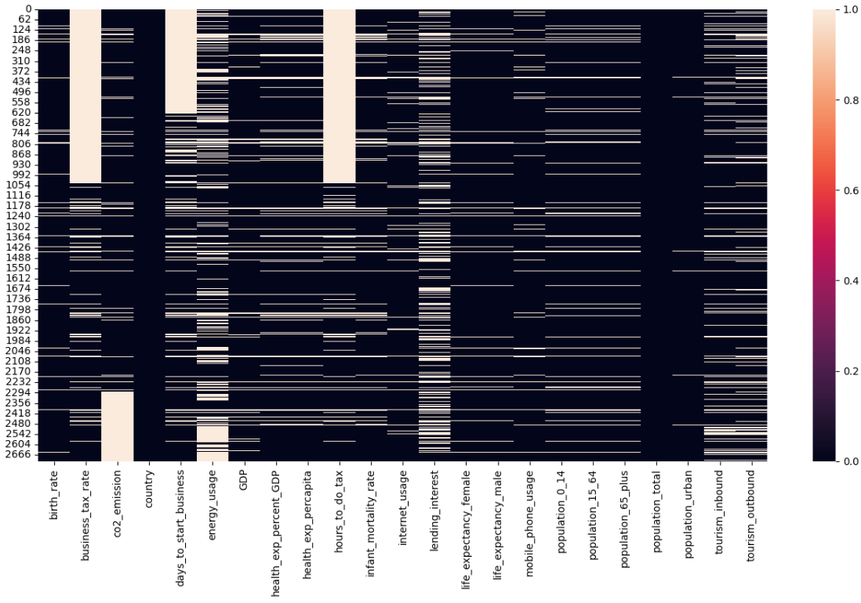
Heatmap for null values

Slide 10
Interpretations on Boxplots: business_tax_rate, co2_emission, days_to_start_business, energy_usage, GDP, health_exp%_GDP, health_exp_percapita, hours_to_do tax, population_total, tourism_inbound, tourism_outbound are having more number of Outliers
. infant_mortality_rate, life_expectancy_female, life_expectancy_male, moble_phone_usage, population_15_64, population_65+ are having few number of Outliers
. The boxplots of Birth Rate,Ease of Business ,Mobile Phone Usage,Internet Usage,Infant Mortality Rate,Life Expectancy Female,Life Expectancy Male,,Population 0-14,Population 15-64,Population 65+, Population Urban looks fine.

Slide 11
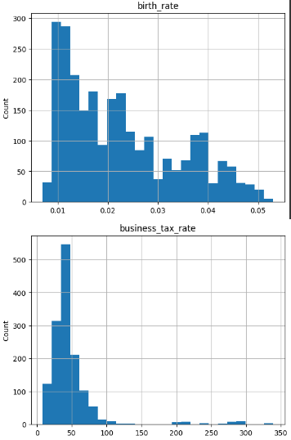
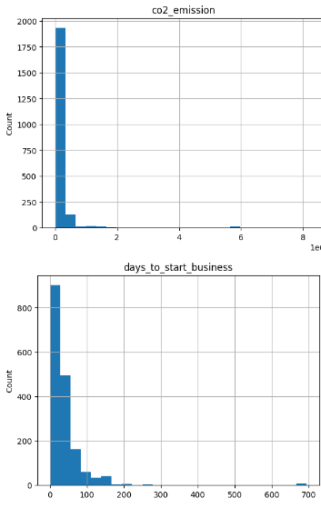

Slide 12
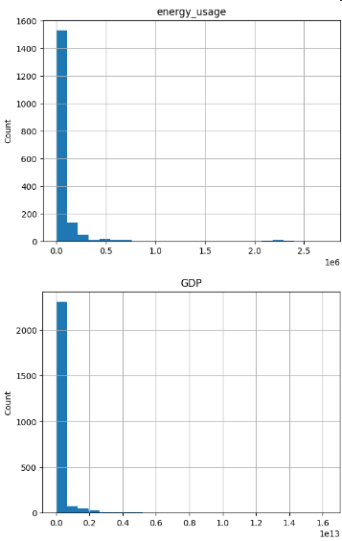
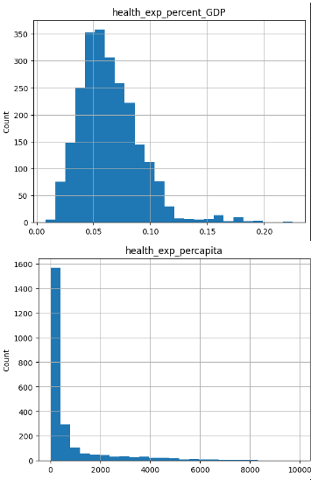

Slide 13
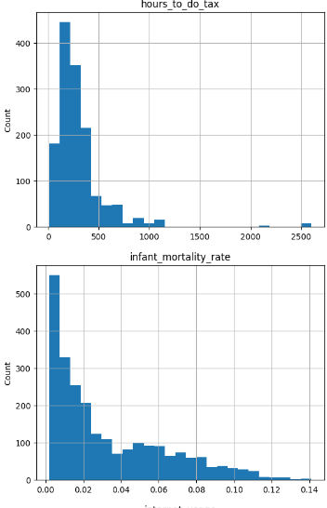
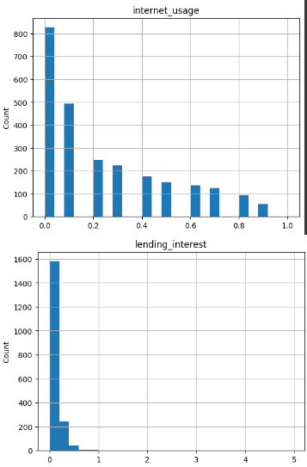

Slide 14
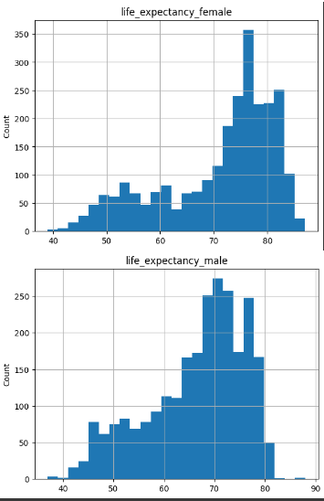
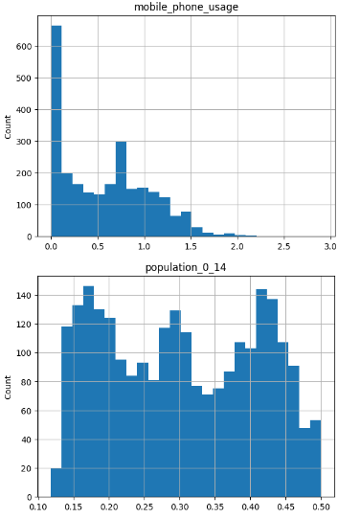

Slide 15
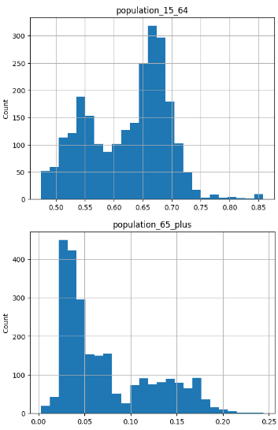
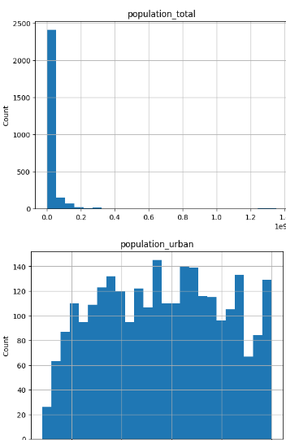

Slide 16
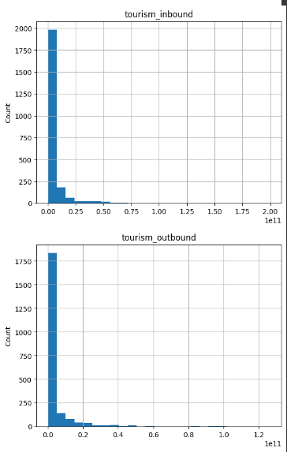

Slide 17
Outlier Detection:
#Interpretations on Skewness of Features.lending_interest, GDP, population_total, co2_emission, days_to_start_business, tourism_inbound, energy_usage, tourism_outbound features are highly skewed.
Need to find a way to reduce the skewness for the above mentioned features

Slide 18
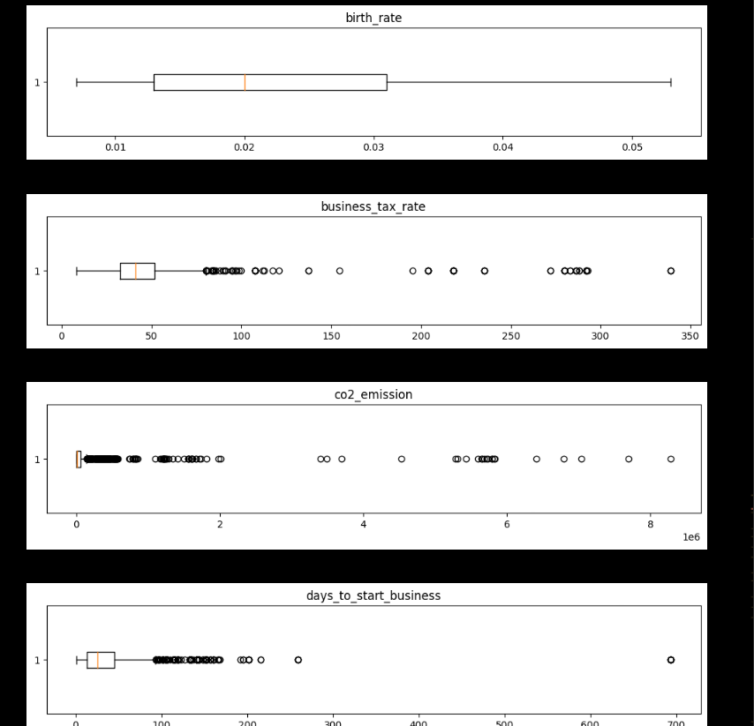
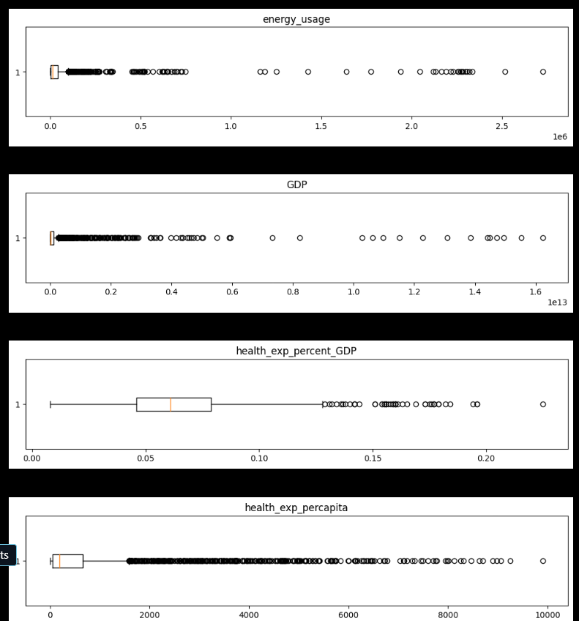
#Before imputation let us check for outliers using boxplot and histograms

Slide 19
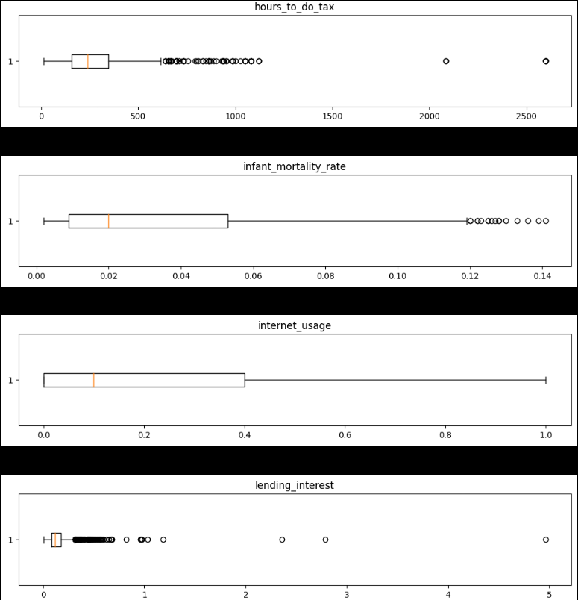
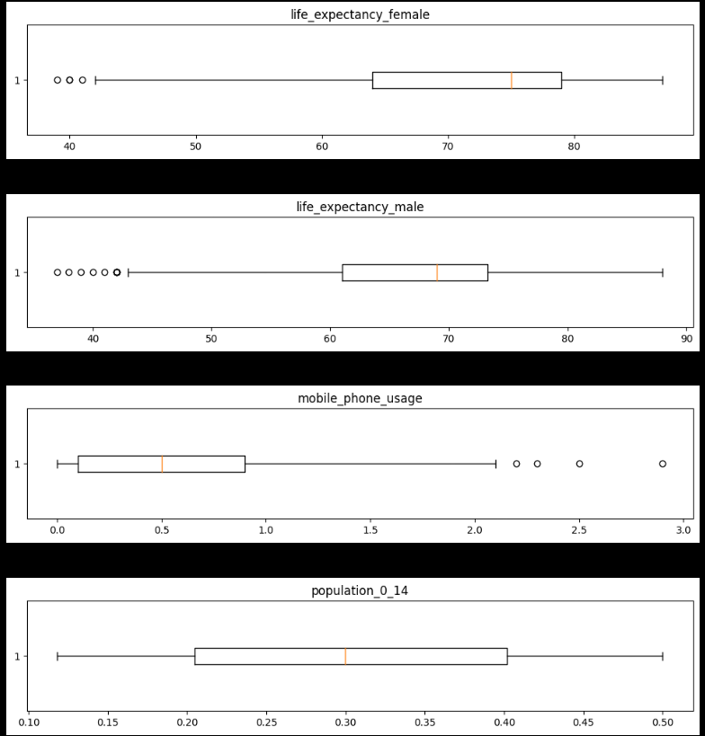
Boxplot

Slide 20
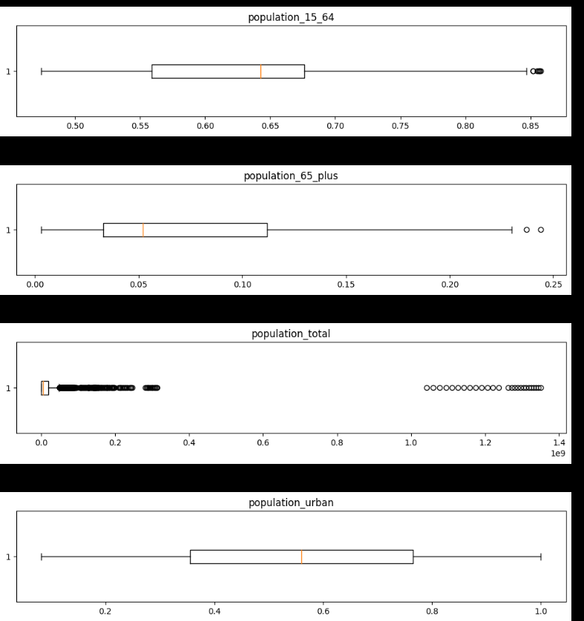
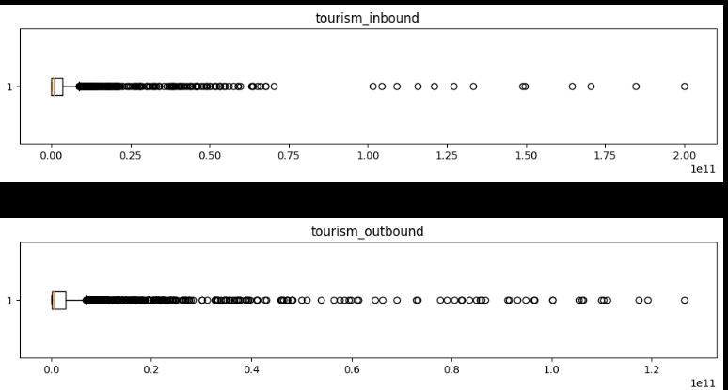
Boxplot

Slide 21
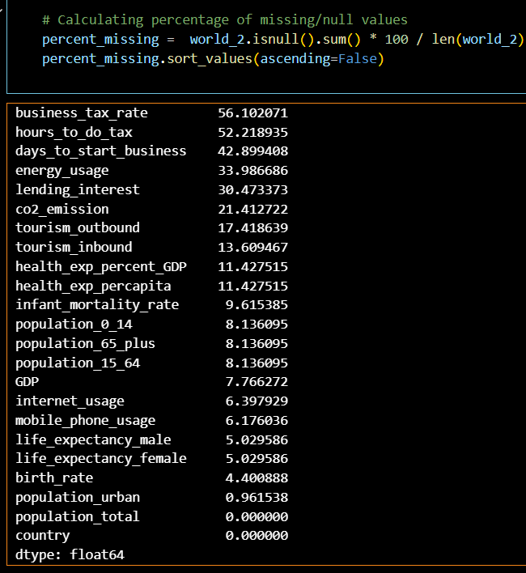
Calculating percentage of missing / null values

Slide 22
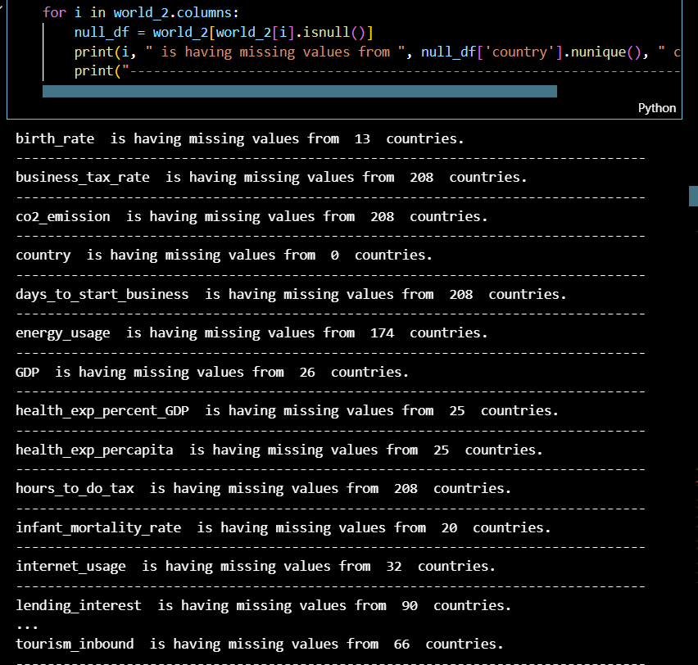
#Country & Feature wise Mean ImputationI missing values with country and feature wise mean, as if the imputation is done through the mean of feature may mislead the data.

Slide 23
Few outliers are detected but it make sense as it is global data and not much deviated from the actual values.​
. max(Business Tax Rate) is around 340% , which means paying 340 rupees as tax for every 100 rupees profit. The global highest Business Tax Rate is around 55% , so assuming the max value to be 60% and replacing all the ouliers (i.e., above 60%) with np.nan and will fill them later using imputation techniques​
' max(Days to Start Business) is 694 days. Accounting 18-20 business days a month it takes like around 3 years , comparing it to real time global values the max time required to start a business is around 50 days.Based on the boxplot assuming the max days to start a business is 80 days and replacing all the outliers with np.nan and will figure a way to fill them up with sensible number later based on all other parameters​
. Based on the boxplot assuming 600 hours as max(hours to do tax ) and replacing all the outliers with np.nan and will figure a way to fill them up with sensible number later based on all other parameters.​

Slide 24
KNN Imputation
KNN Imputation as well for whichever countries having null values for the entire feature, but median imputation is giving better results, hence going ahead with median imputation

Slide 25
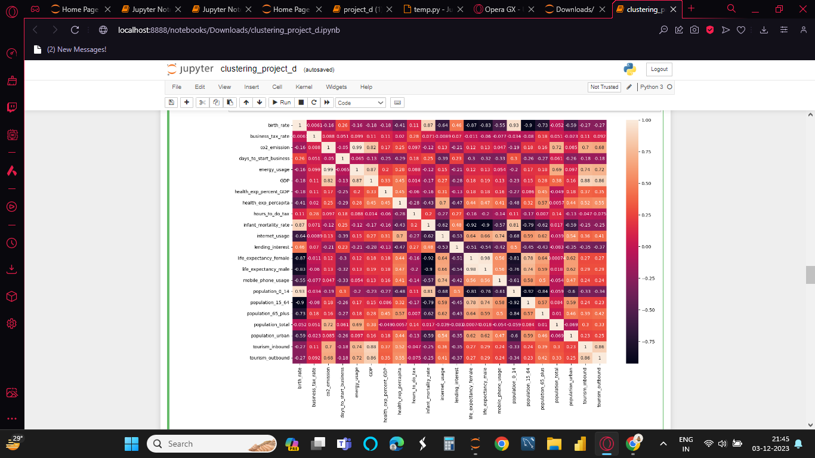
Heatmap for Correlation

Slide 26
Hopkins test
Hopkins test Hopkins test is a way of measuring the cluster tendency of a dataset the Hopkins statistic, is a statistic which gives a value which indicates the cluster tendency, in other words: how well the data can be clustered.
.. If the value is between {0.01, ...,0.3}, the data is regularly spaced.
..If the value is around 0.5, it is random.
..If the value is between {0.7, ..., 0.99}, it has a high tendency to cluster.measuring

Slide 27
Hopkins test results will vary as it picks a set of samples each time. On running it multiple times, it can be seen that this data set gives Hopkins statistic value in the range of 0.88 to 0.97 and hence our dataset is good for clustering and lets proceed our analysis

Slide 28
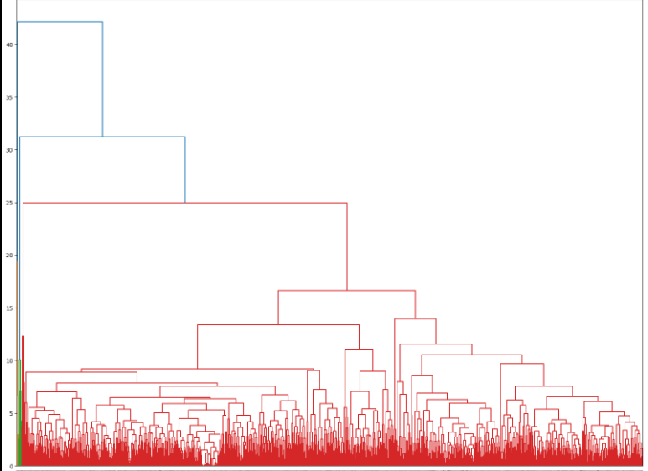
#Agglomeritive or Hierarchical Clustering

Slide 29
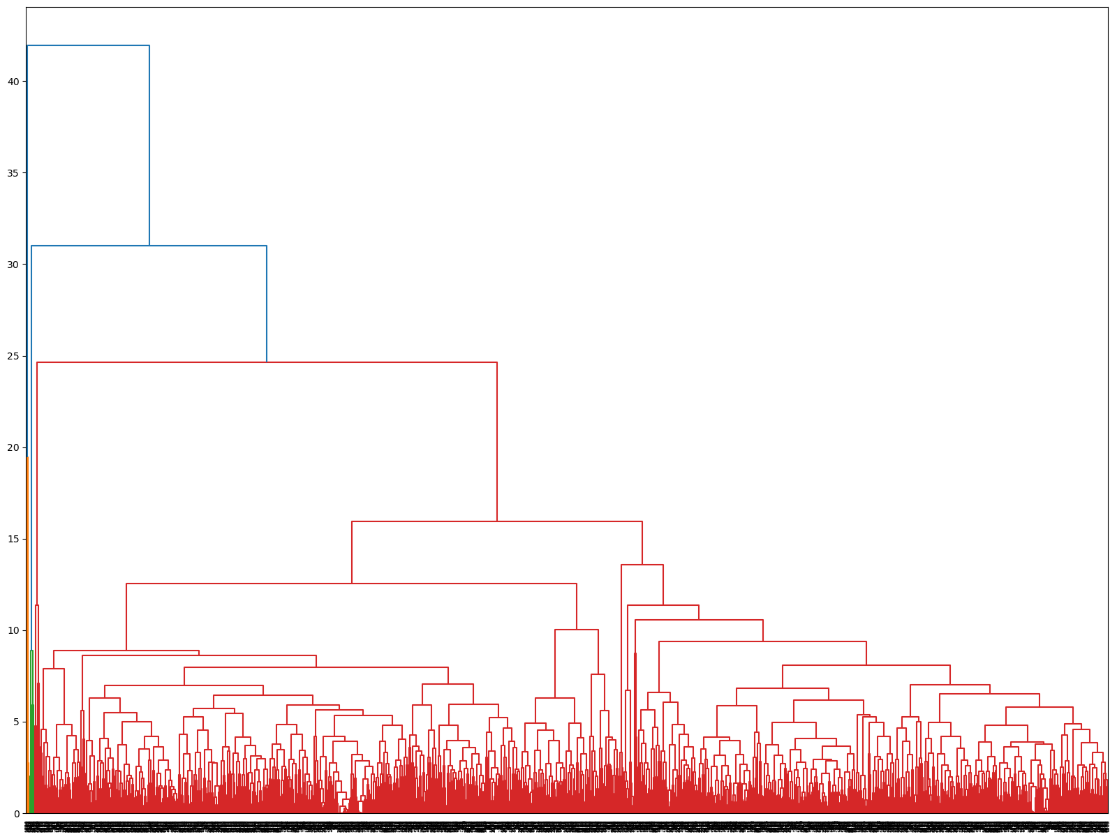
#Agglomeritive or Hierarchical Clustering using PCA values

Slide 30
K-Means Clustering
k-means clustering tries to group similar kinds of items in form of clusters. It finds the similarity between the items and groups them into the clusters.

Slide 31
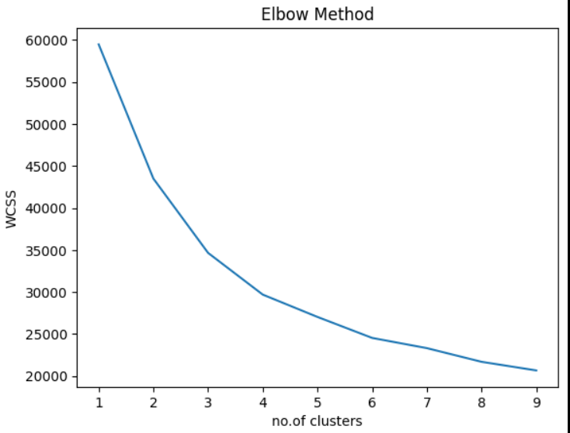
K-Means Clustering

Slide 32
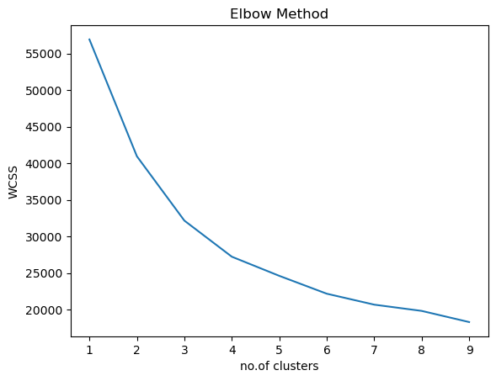
# K-means clustering using PCA values

Slide 33

#DBSCAN Clustering
DBSCAN model for pca data

Slide 34
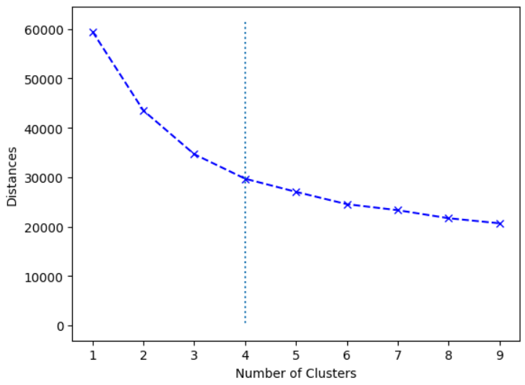
From the above elbow method diagram we can say that no.of clusters = 4

Slide 35
#Principal Component Analysis
a dimensionality reduction method that is often used to reduce the dimensionality of large data sets, by transforming a large set of variables into a smaller one that still contains most of the information in the large set.

Slide 36
#Training and Testing the model accuracy using Random Forest
Saving the Random Forest model for future prediction
0.9679802955665024 % Acuuracy

Slide 37
Decision_Tree
A decision Tree regressor is tree like Structure that It has a hierarchical, tree structure, which consists of a root node, branches, internal nodes and leaf nodes.
Then do the hyper parameter tuning on the parameters of the decision tree then it gives the best parameters for the decision tree regressor.
Then build the model based on it and then fit the model and then do the cross validation on it.

Slide 38
Challenges:
Values are independently corelated with each other so its difficult to get relation
We have so many models so its hard to select from them, for selecting model we check accuracy of each and after checking accuracy we selected Random Forest Regression Model.

Slide 39
Silhouette Coefficients
Agglomeritive or Hierarchical Clustering =0.6142183444547734
K-Means Clustering = 0.2526705329675034
Principal Component Analysis = 0.4655053199055981
Agglomeritive or Hierarchical Clustering using PCA values =0.7630877646244628
K-means clustering using PCA values =0.4657931061008227
DBSCAN Clustering = -0.431

Slide 40
Conclusion
Form all the above models We can observed we are getting maximunm accuracy from Hierarchical Clustering using PCA values Hence considering Hierarchical clusting algorithm as final model.

Slide 41
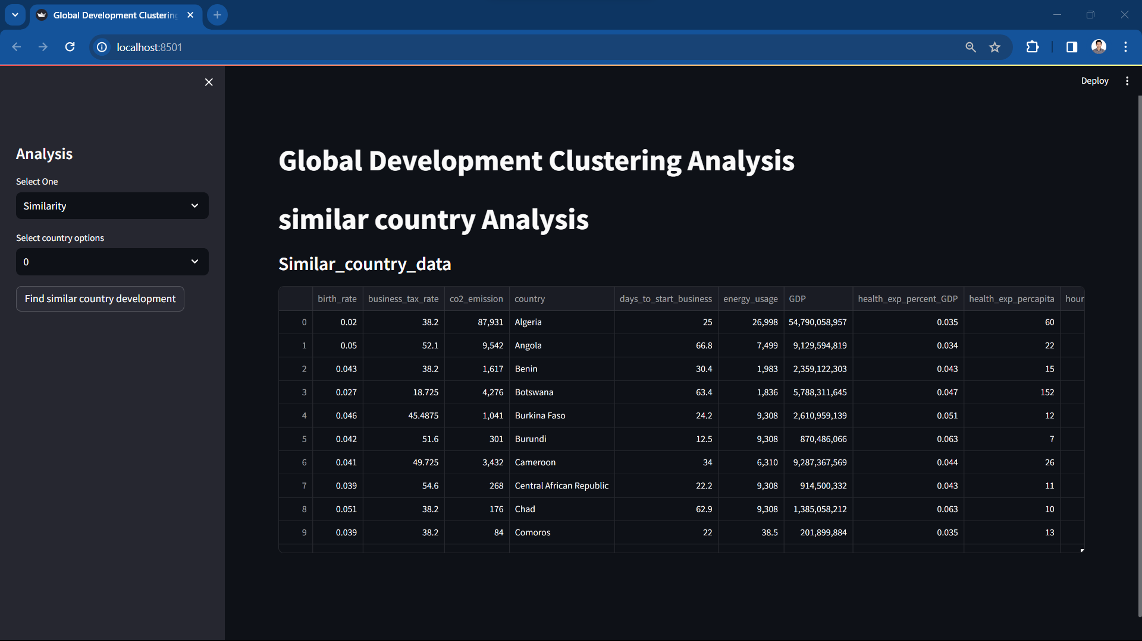
Deployment

Slide 42
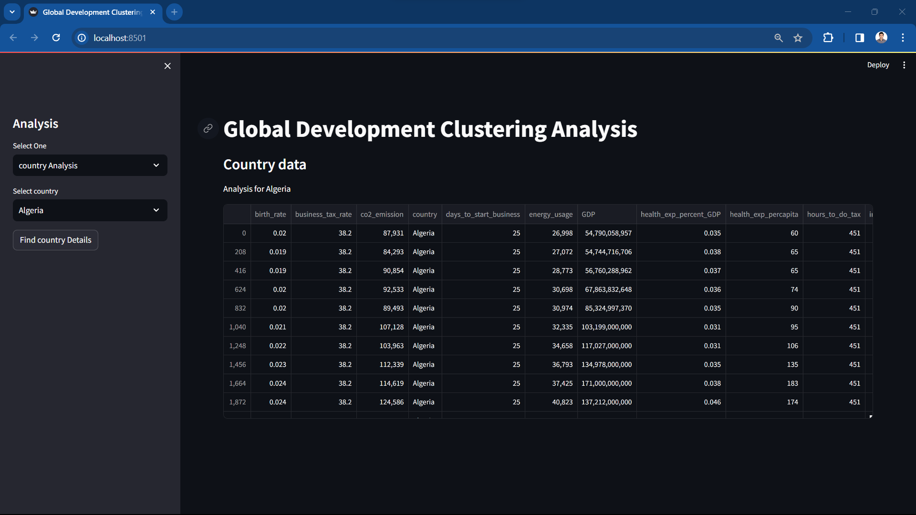
Deployment

Slide 43
Thank You

